Slide 1
MediAssist AI - Healthcare Guidance Platform
Team 3:
Aparna Bharathi Suresh
Pavan Srivatsav Devarakonda
Sai Naga Sanjana Chippada
Shravani Dattaram Gawade
Sujatha Deepraj Joshi

Slide 2
Model Selection
Selected open-source LLMs optimized for chronic disease management, ensuring accuracy, scalability, and patient engagement.
Selected Models:
MedLlama3: General-purpose Q&A and patient education
BioMistral-7B: Biomedical knowledge retrieval and clinical research
MedAlpaca: Lightweight generative medical text and Q&A model,
Meditron: Advanced medical reasoning and differential diagnosis
We have currently fine-tuned the BioMistral-7B and MedAlpaca models on healthcare-specific Q/A datasets, to enhance its performance in biomedical knowledge retrieval and clinical research queries.

Slide 3
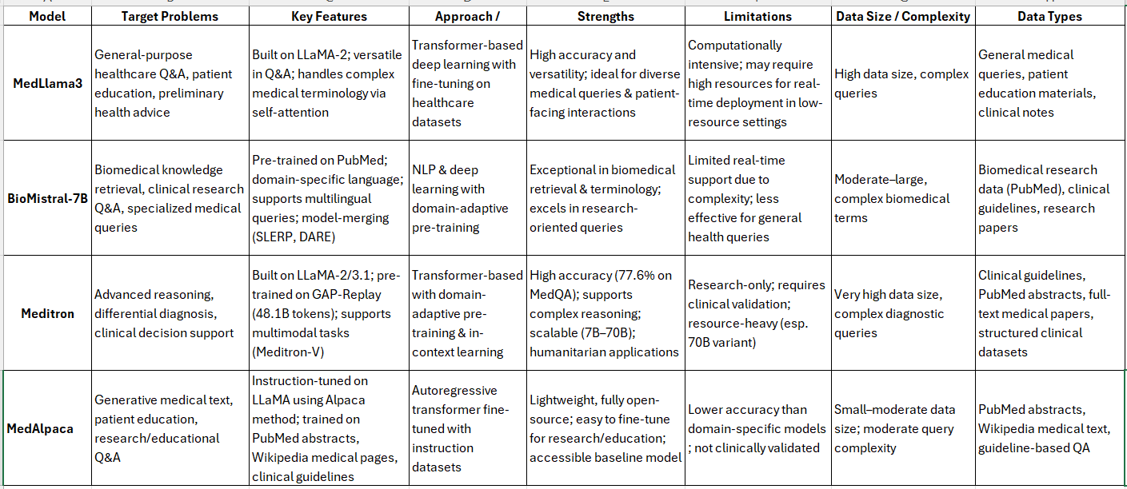

Slide 4
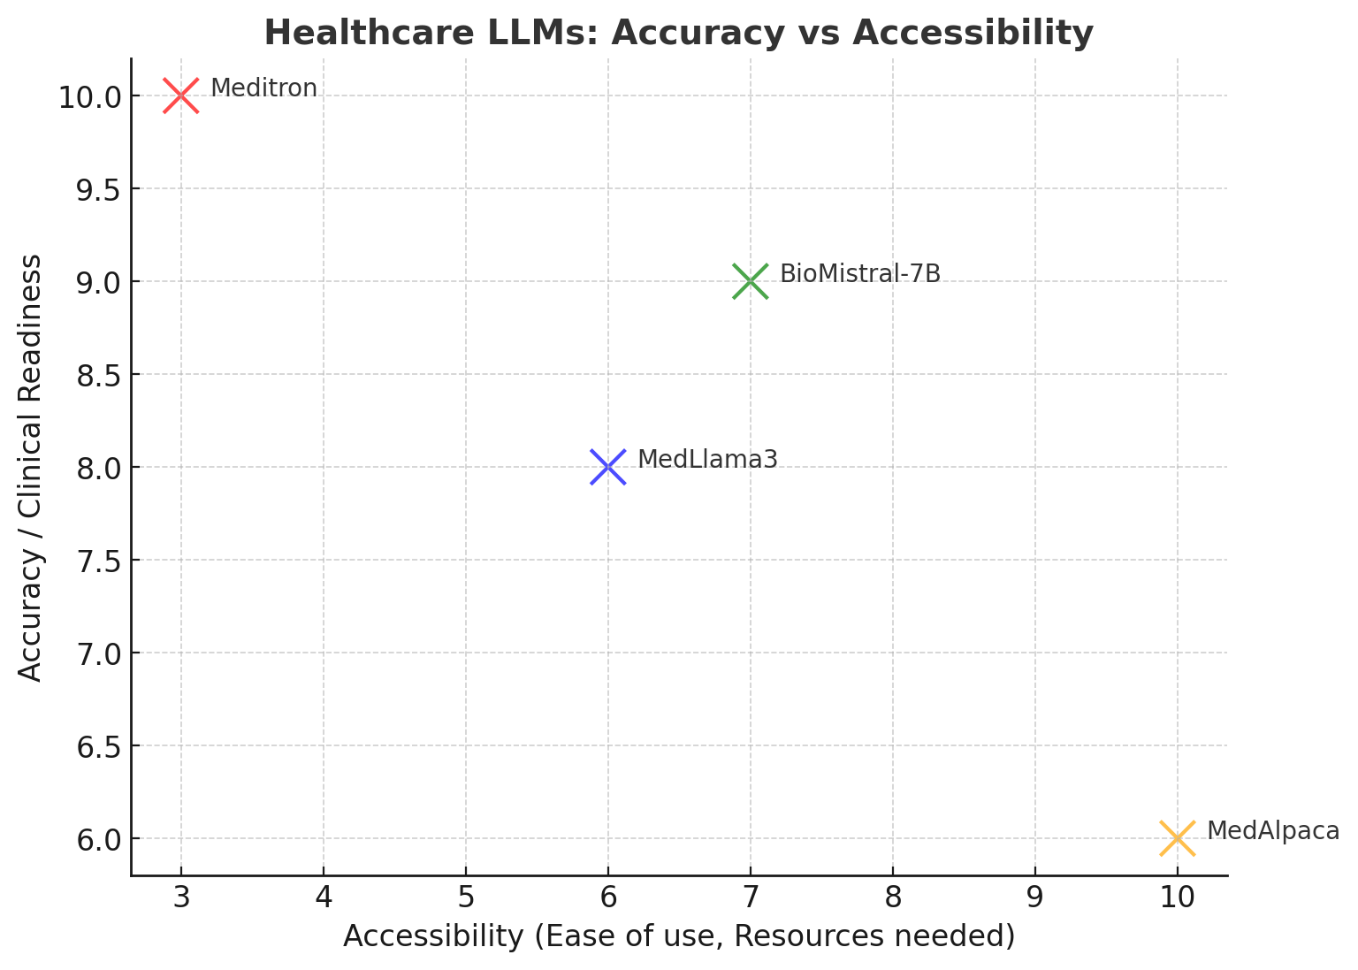

Slide 5
Machine Learning Results

Slide 6
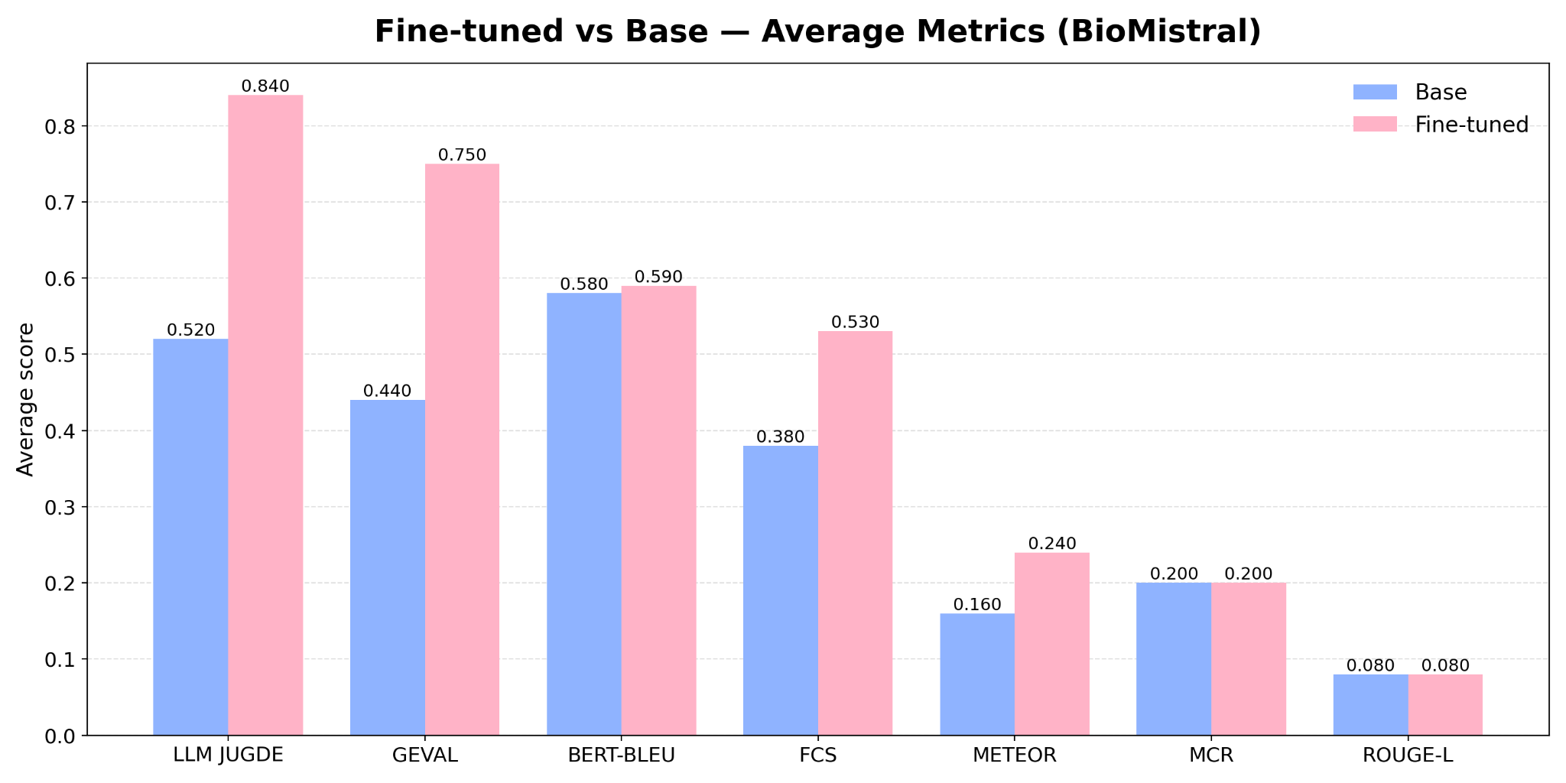

Slide 7
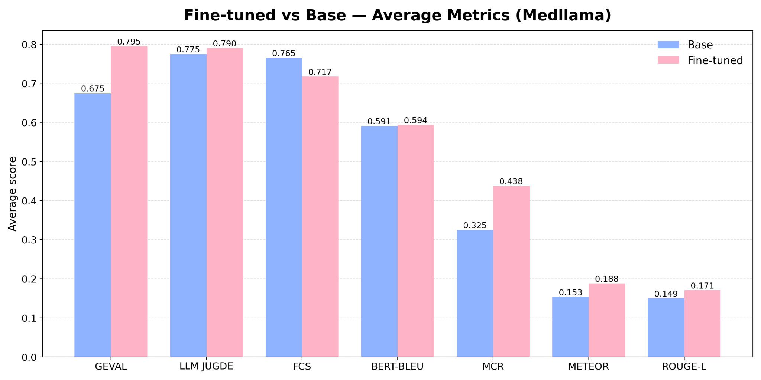

Slide 8
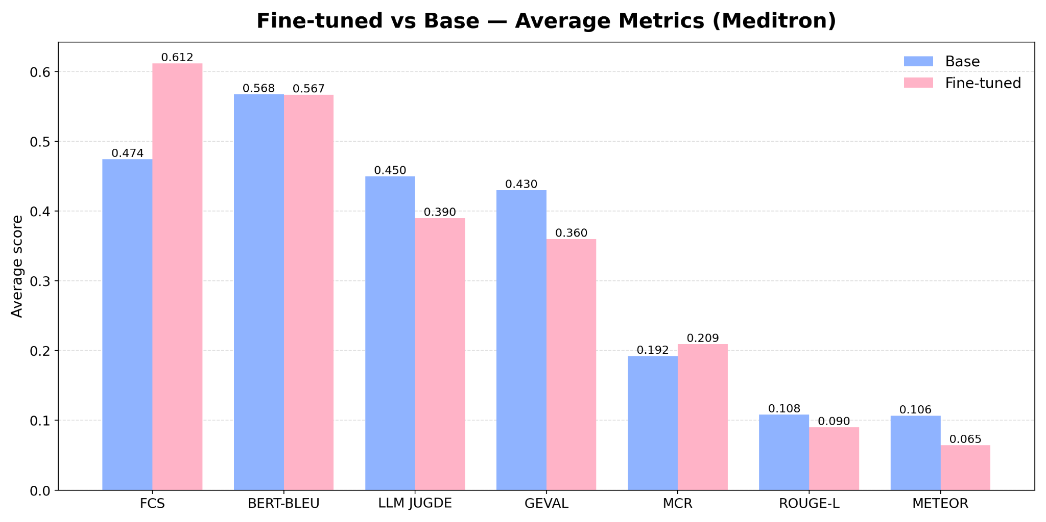

Slide 9
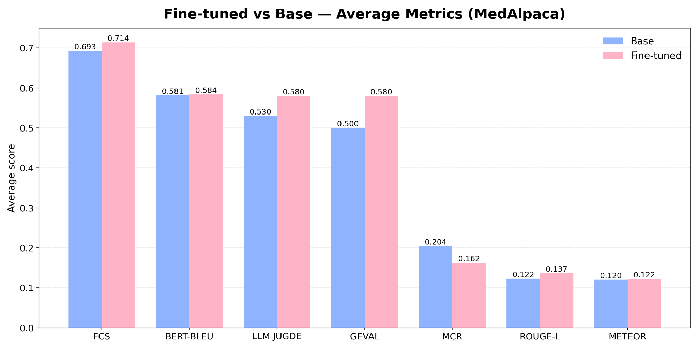

Slide 10
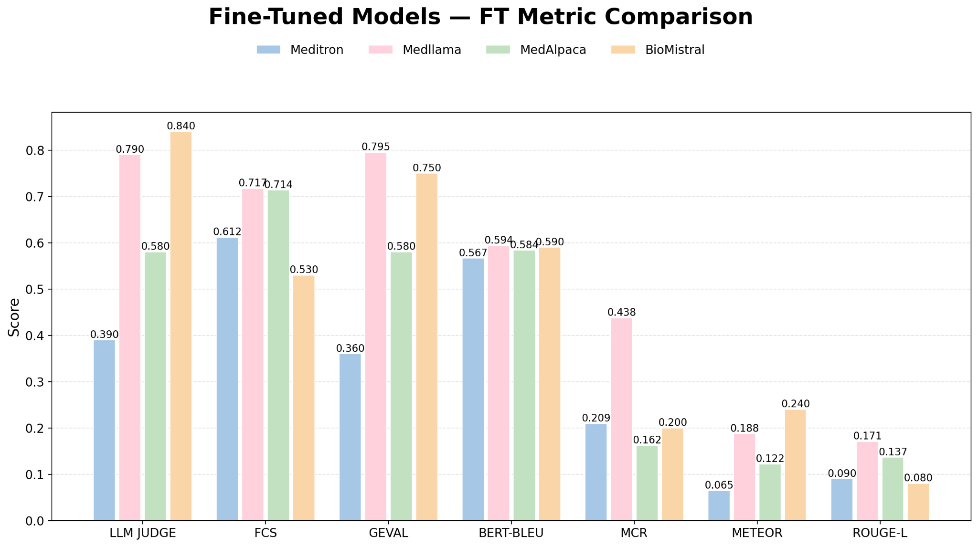

Slide 11
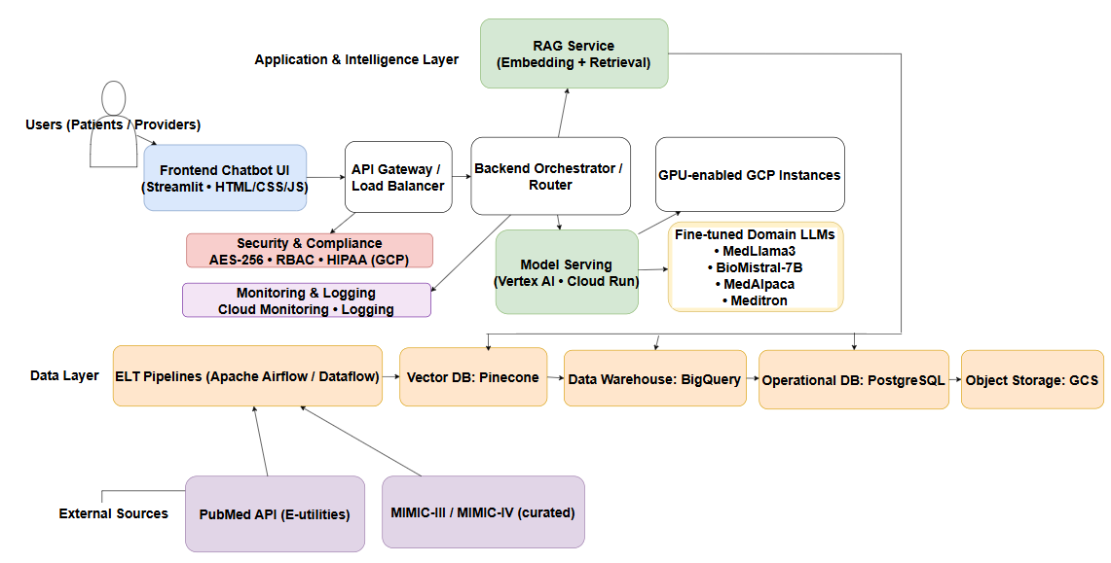
System Design

Slide 12
Demo

Slide 13
Thank You

